Slide 1
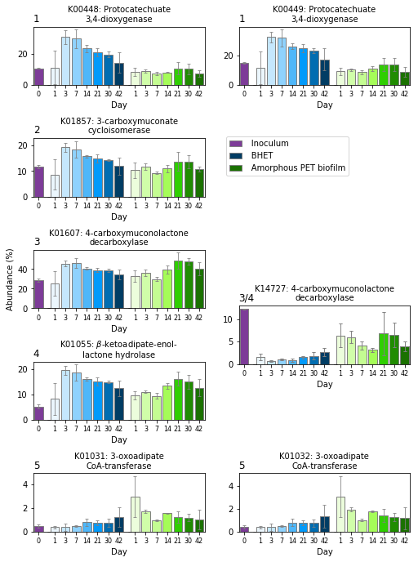


Protocatechuate
(3,4-dihydroxy benzoate)
1
$β$-carboxymuconate
2
$γ$-carboxymuconolactone
3
3-oxoadipate-enol-lactone
4
3-oxoadipate
5
3-oxoadipyl-CoA

Slide 2
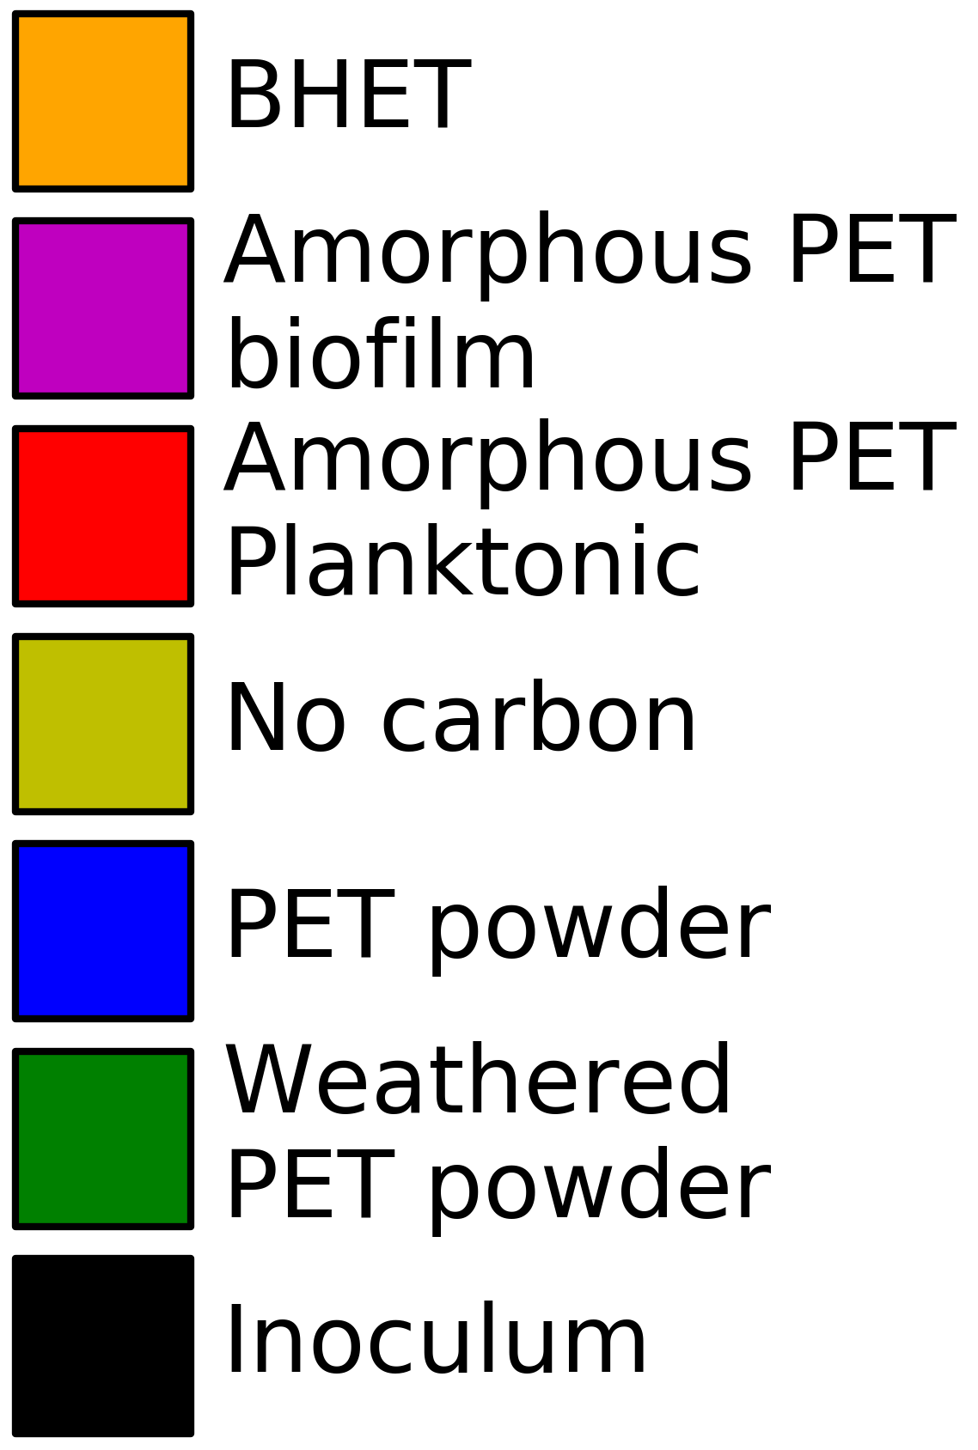
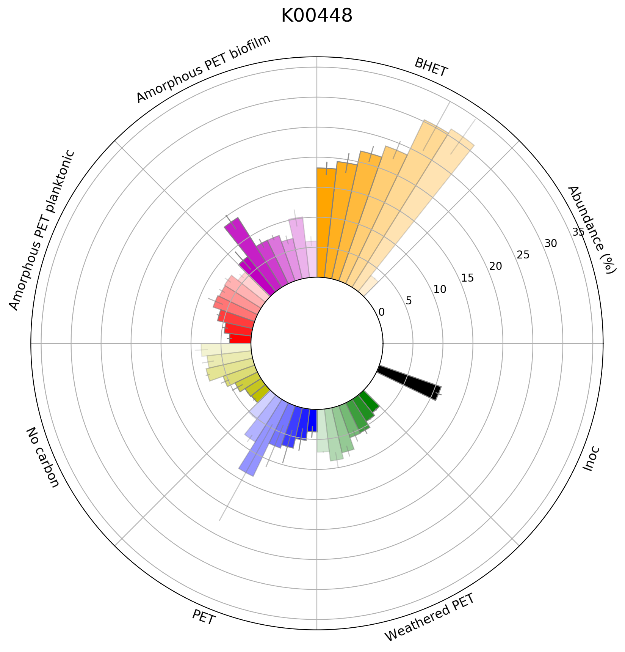
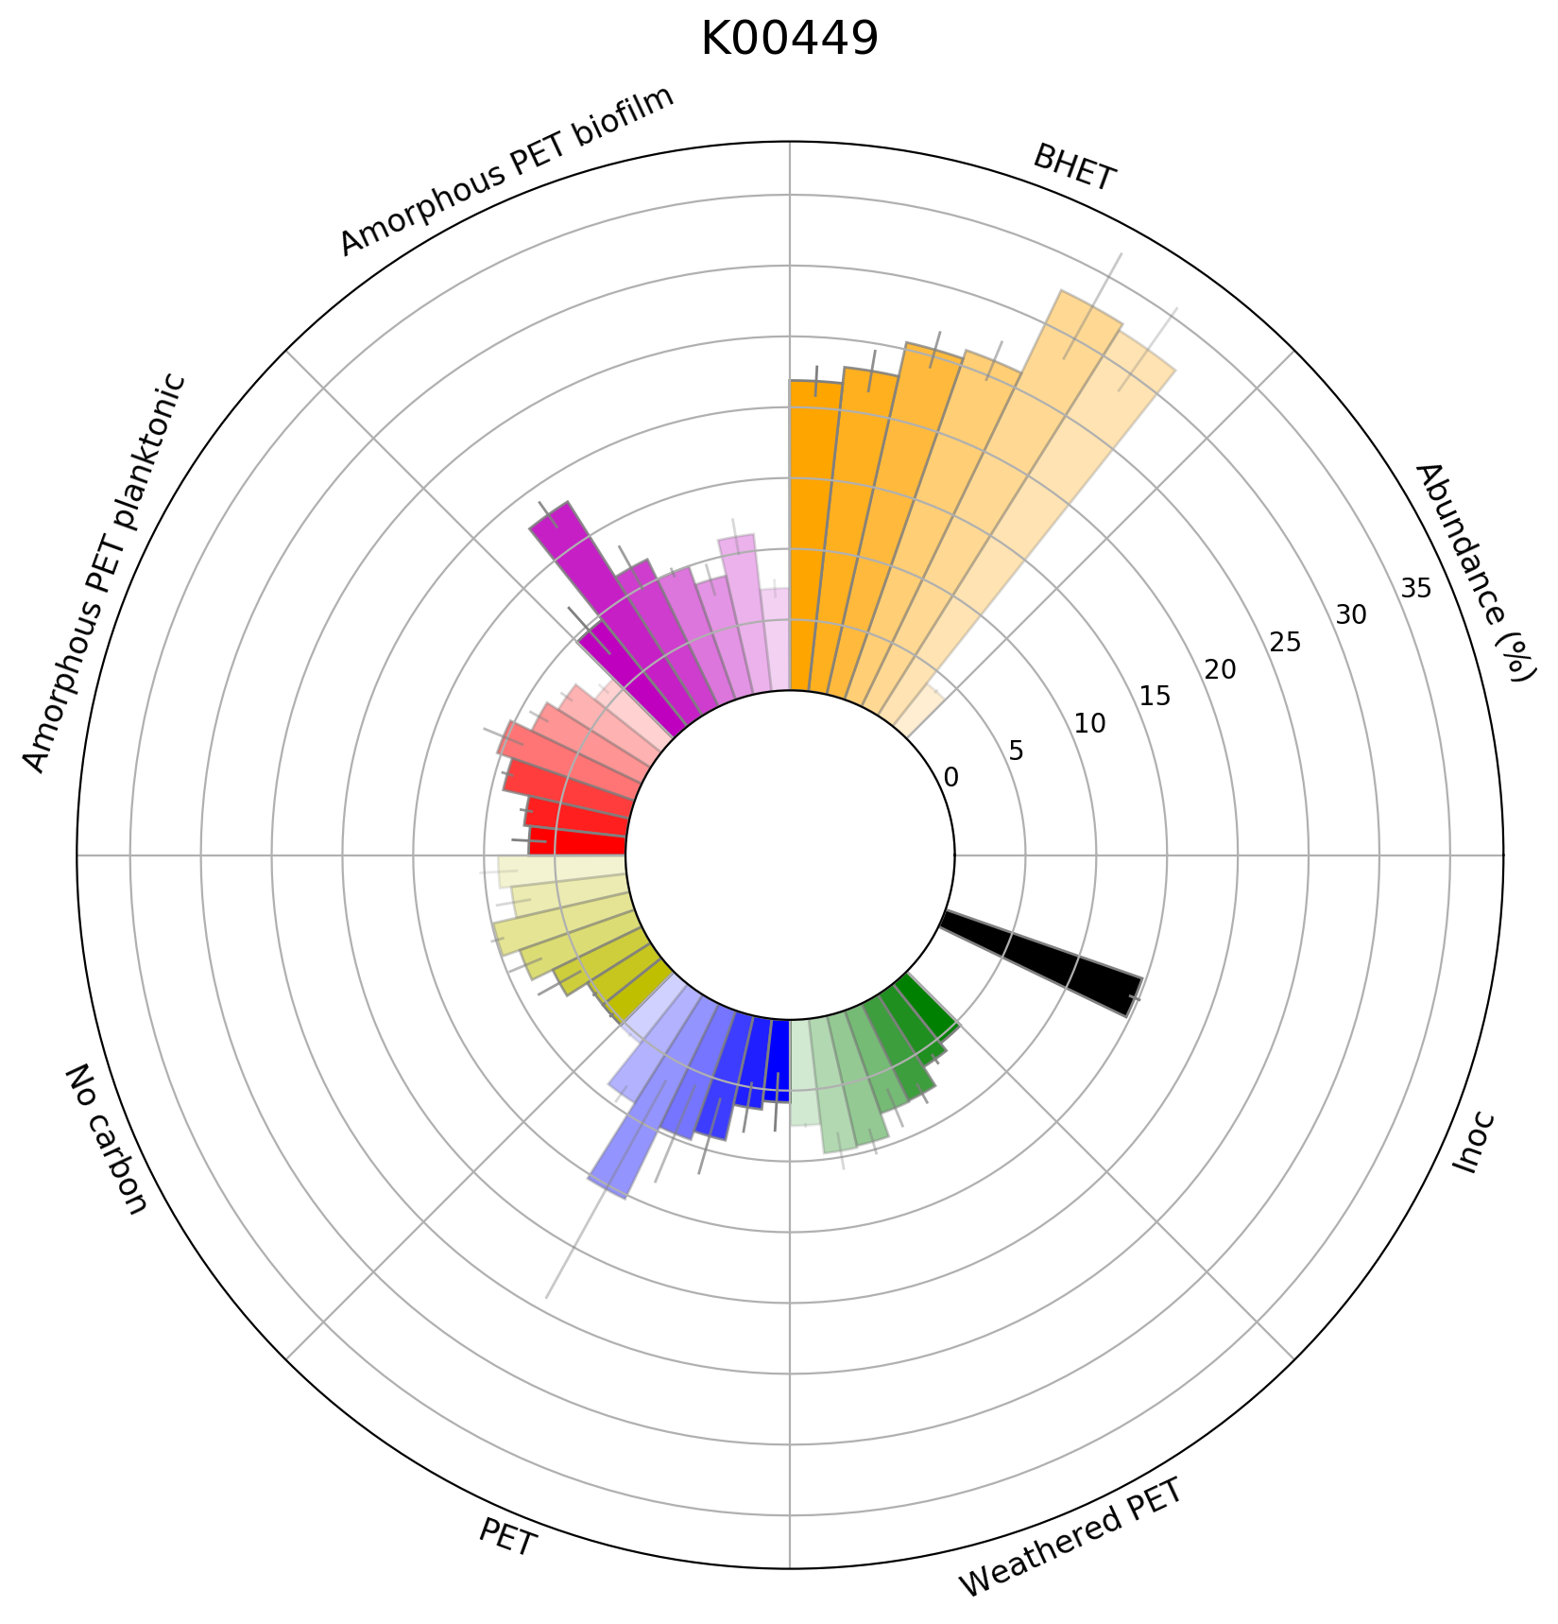
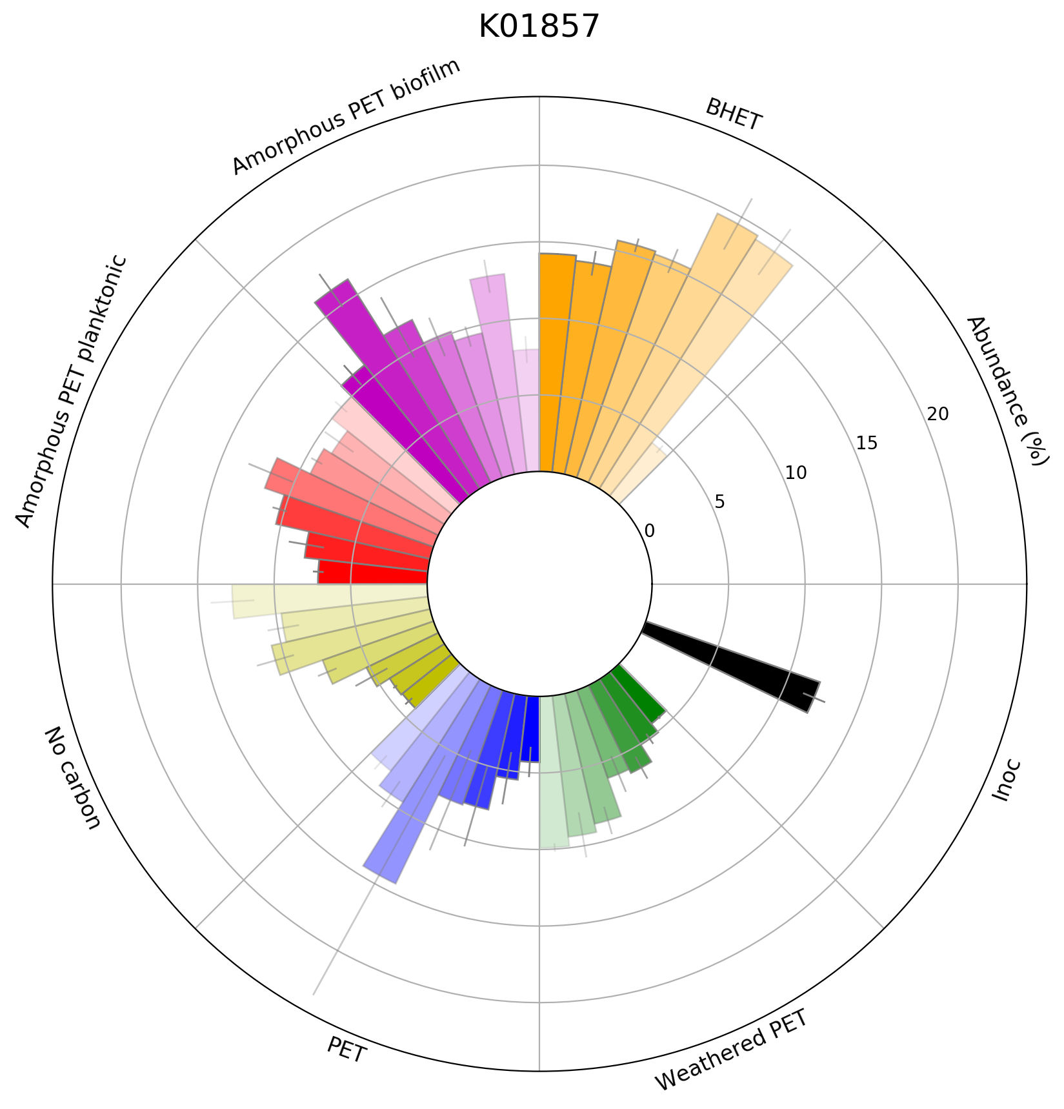
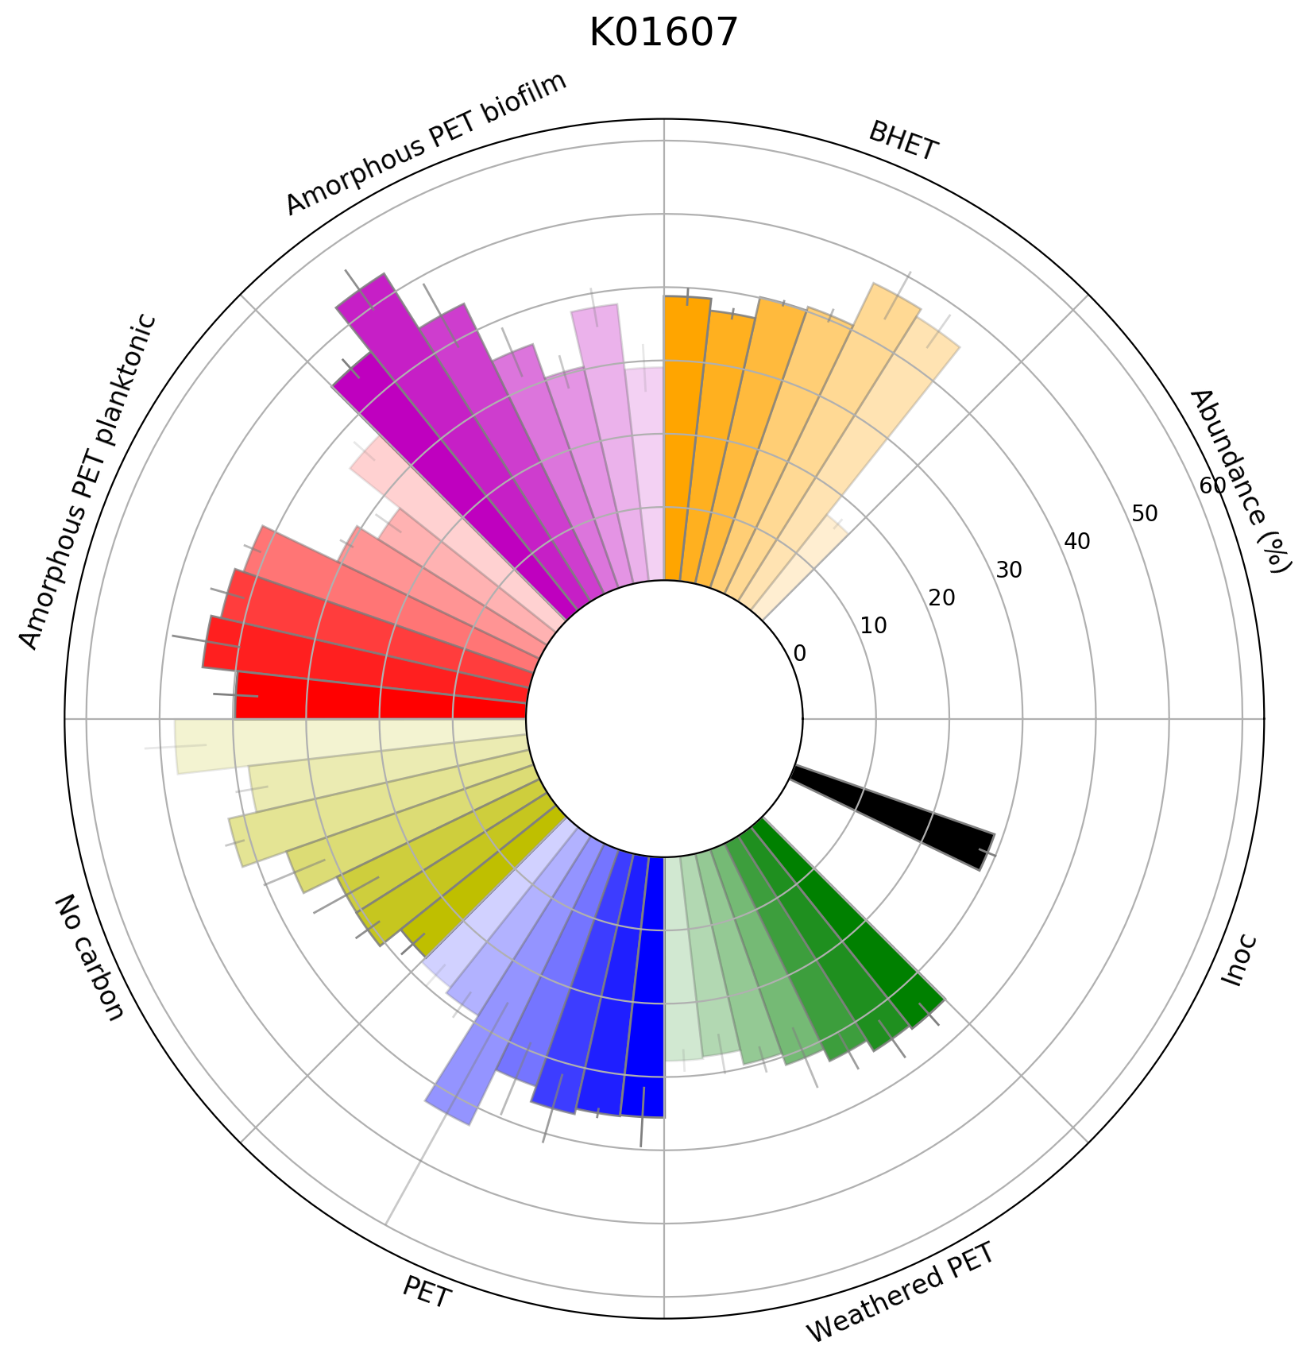
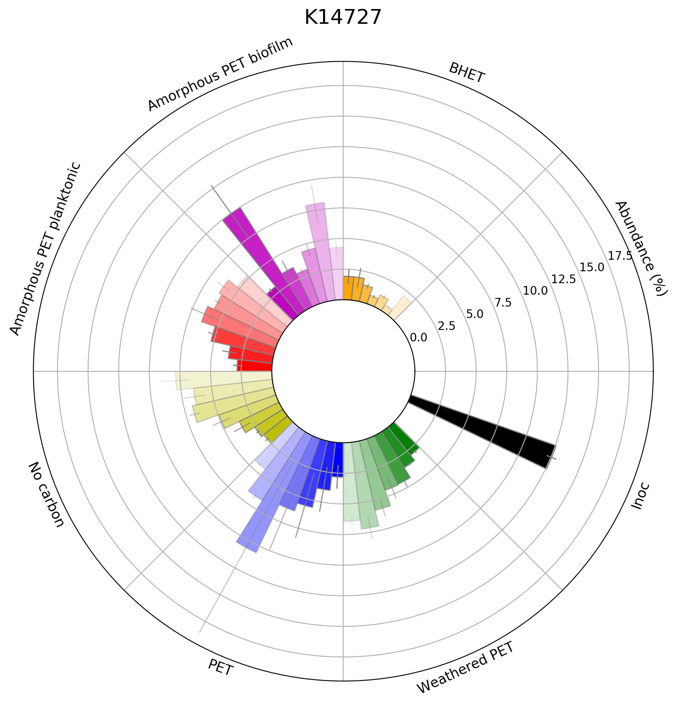
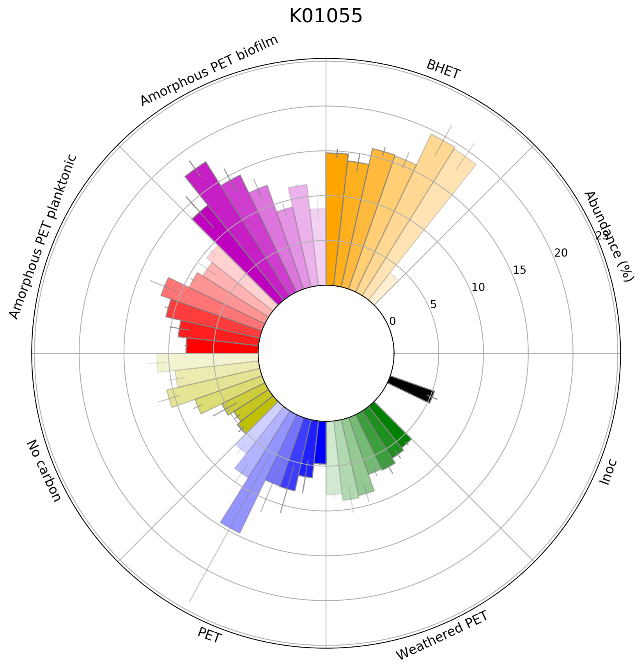
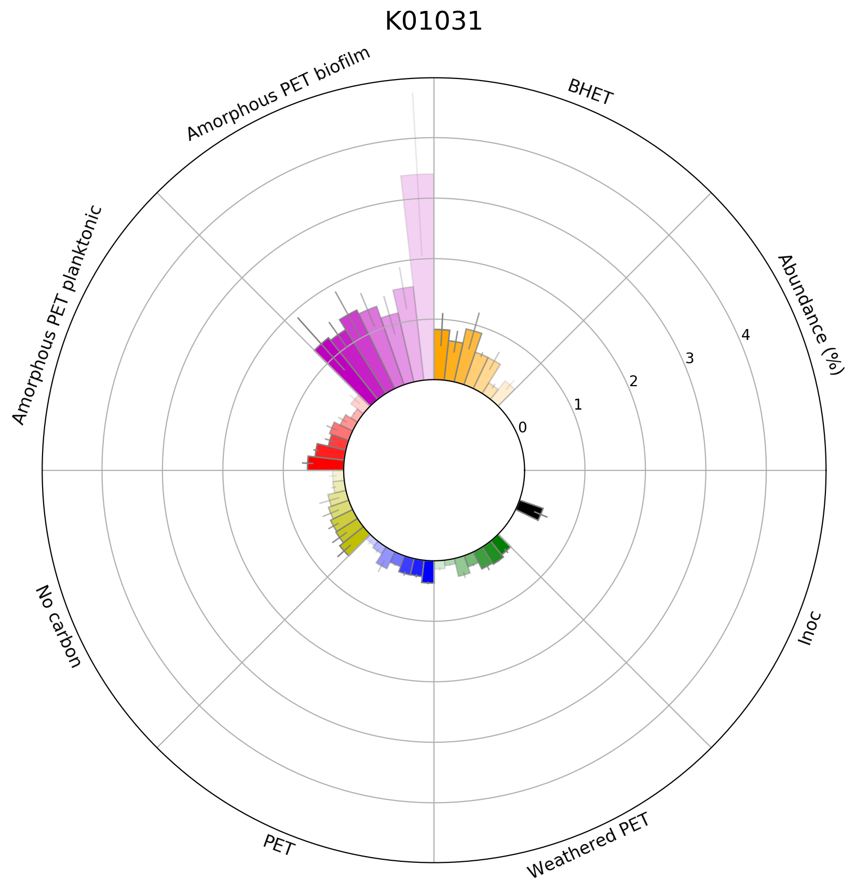



Protocatechuate
$β$-carboxymuconate
$γ$-carboxymuconolactone
3-oxoadipate-enol-lactone
3-oxoadipate
3-oxoadipyl-CoA

Slide 3
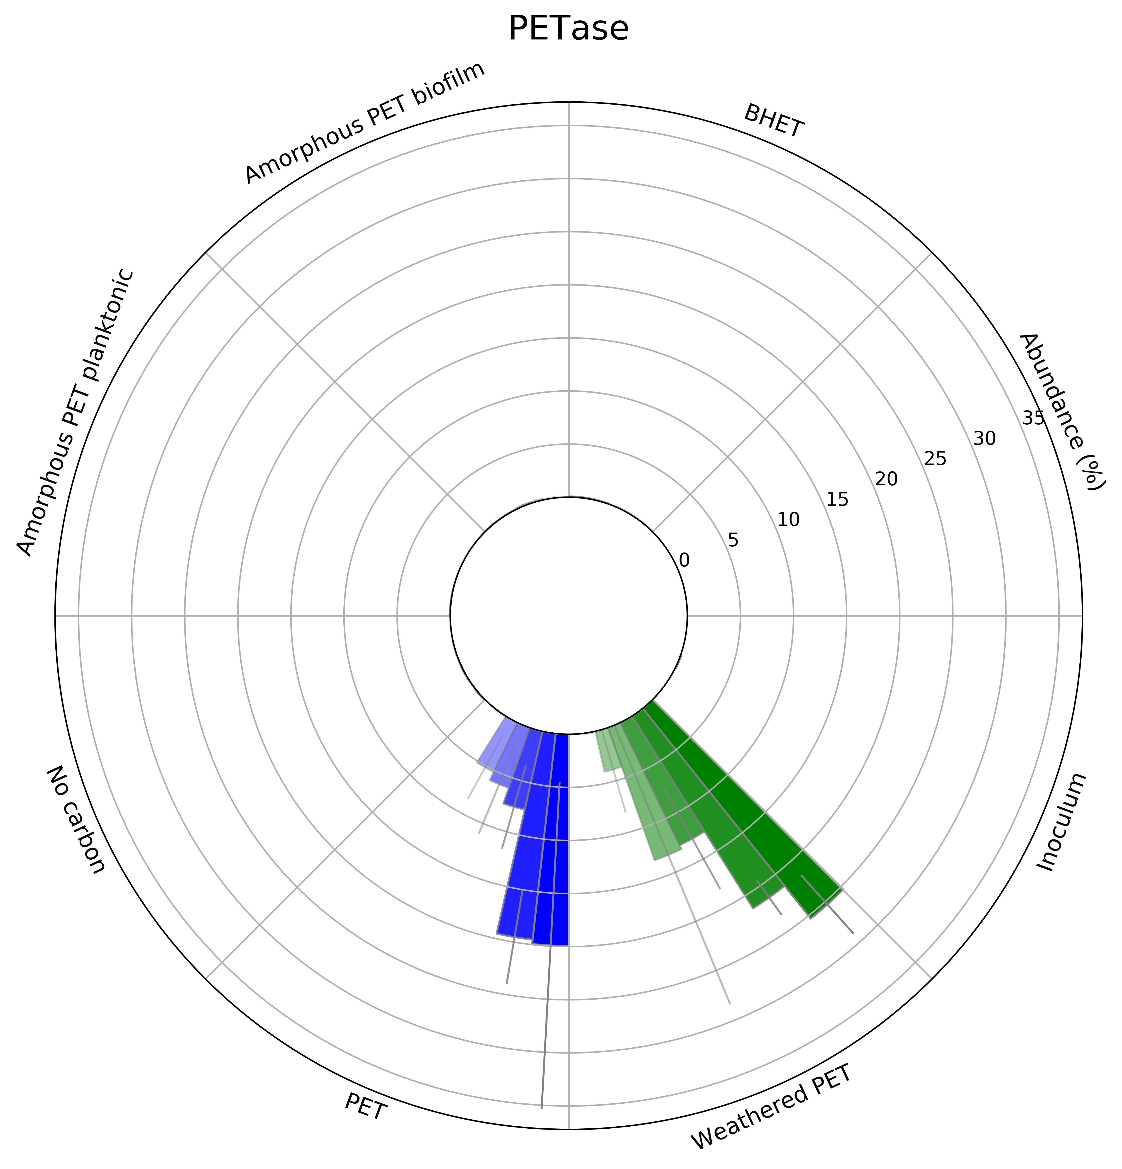
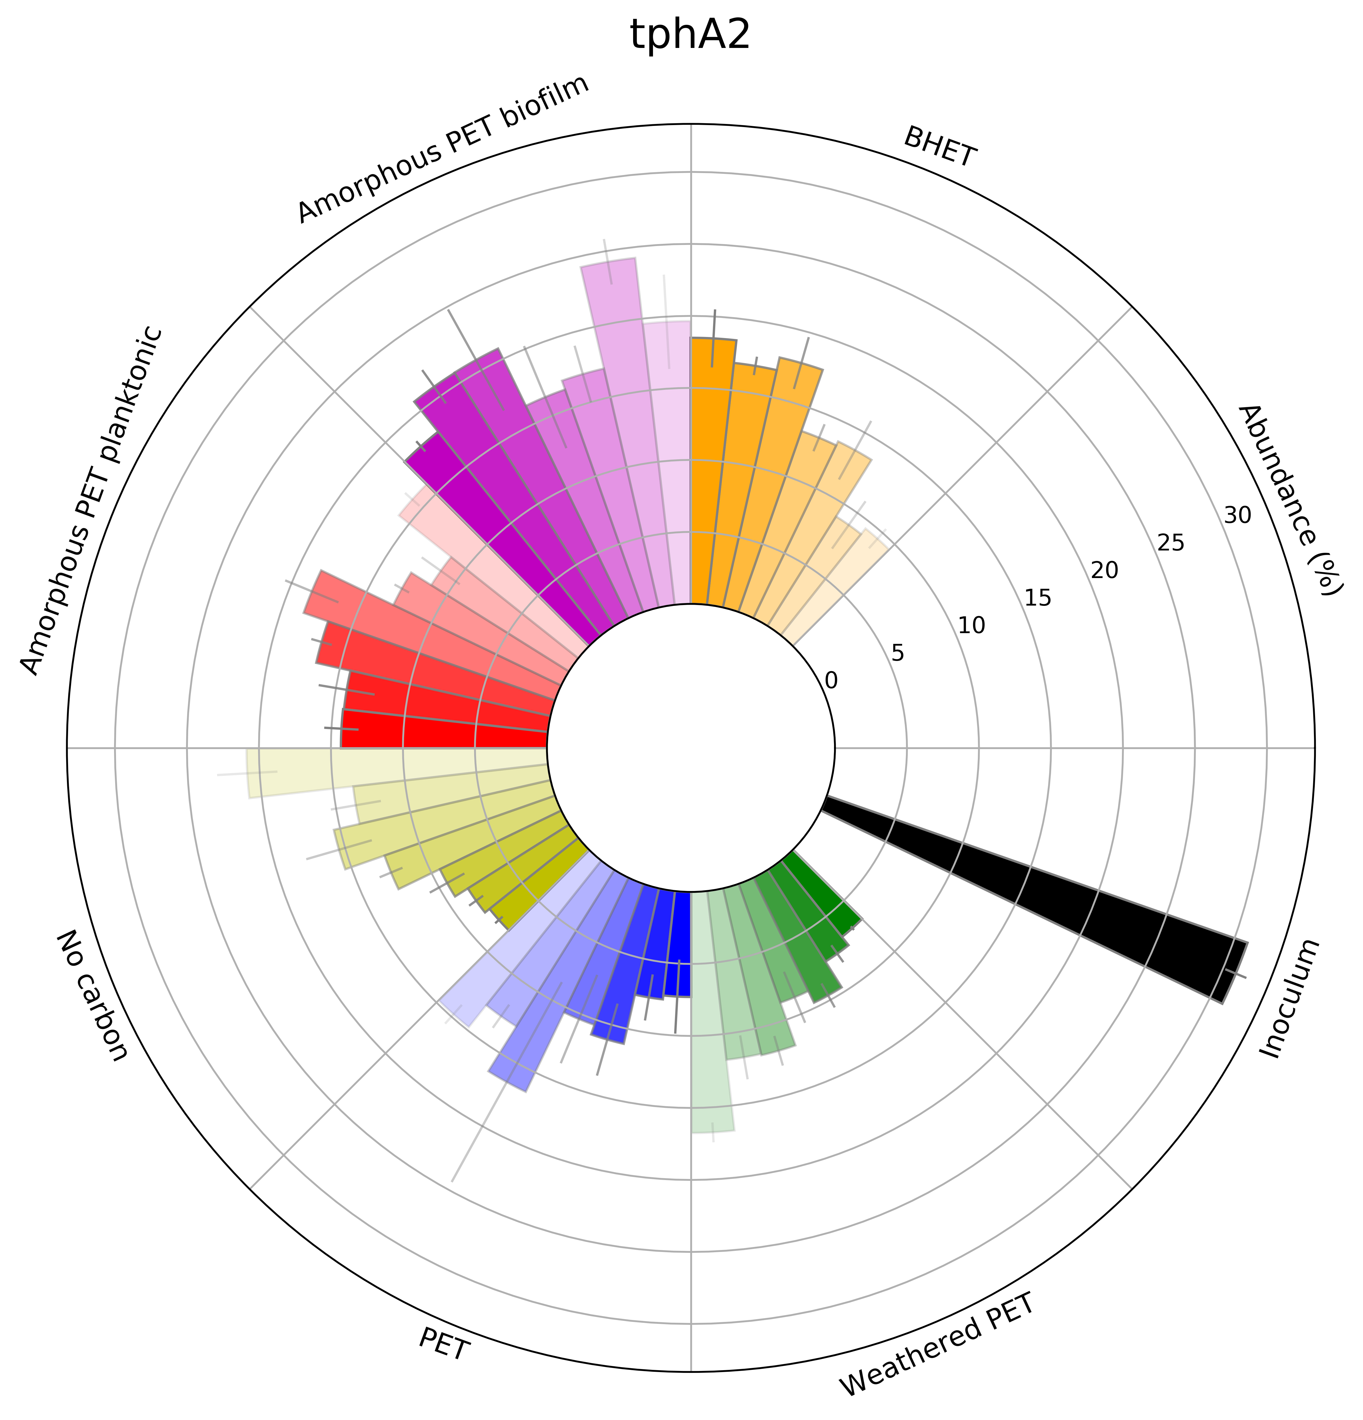
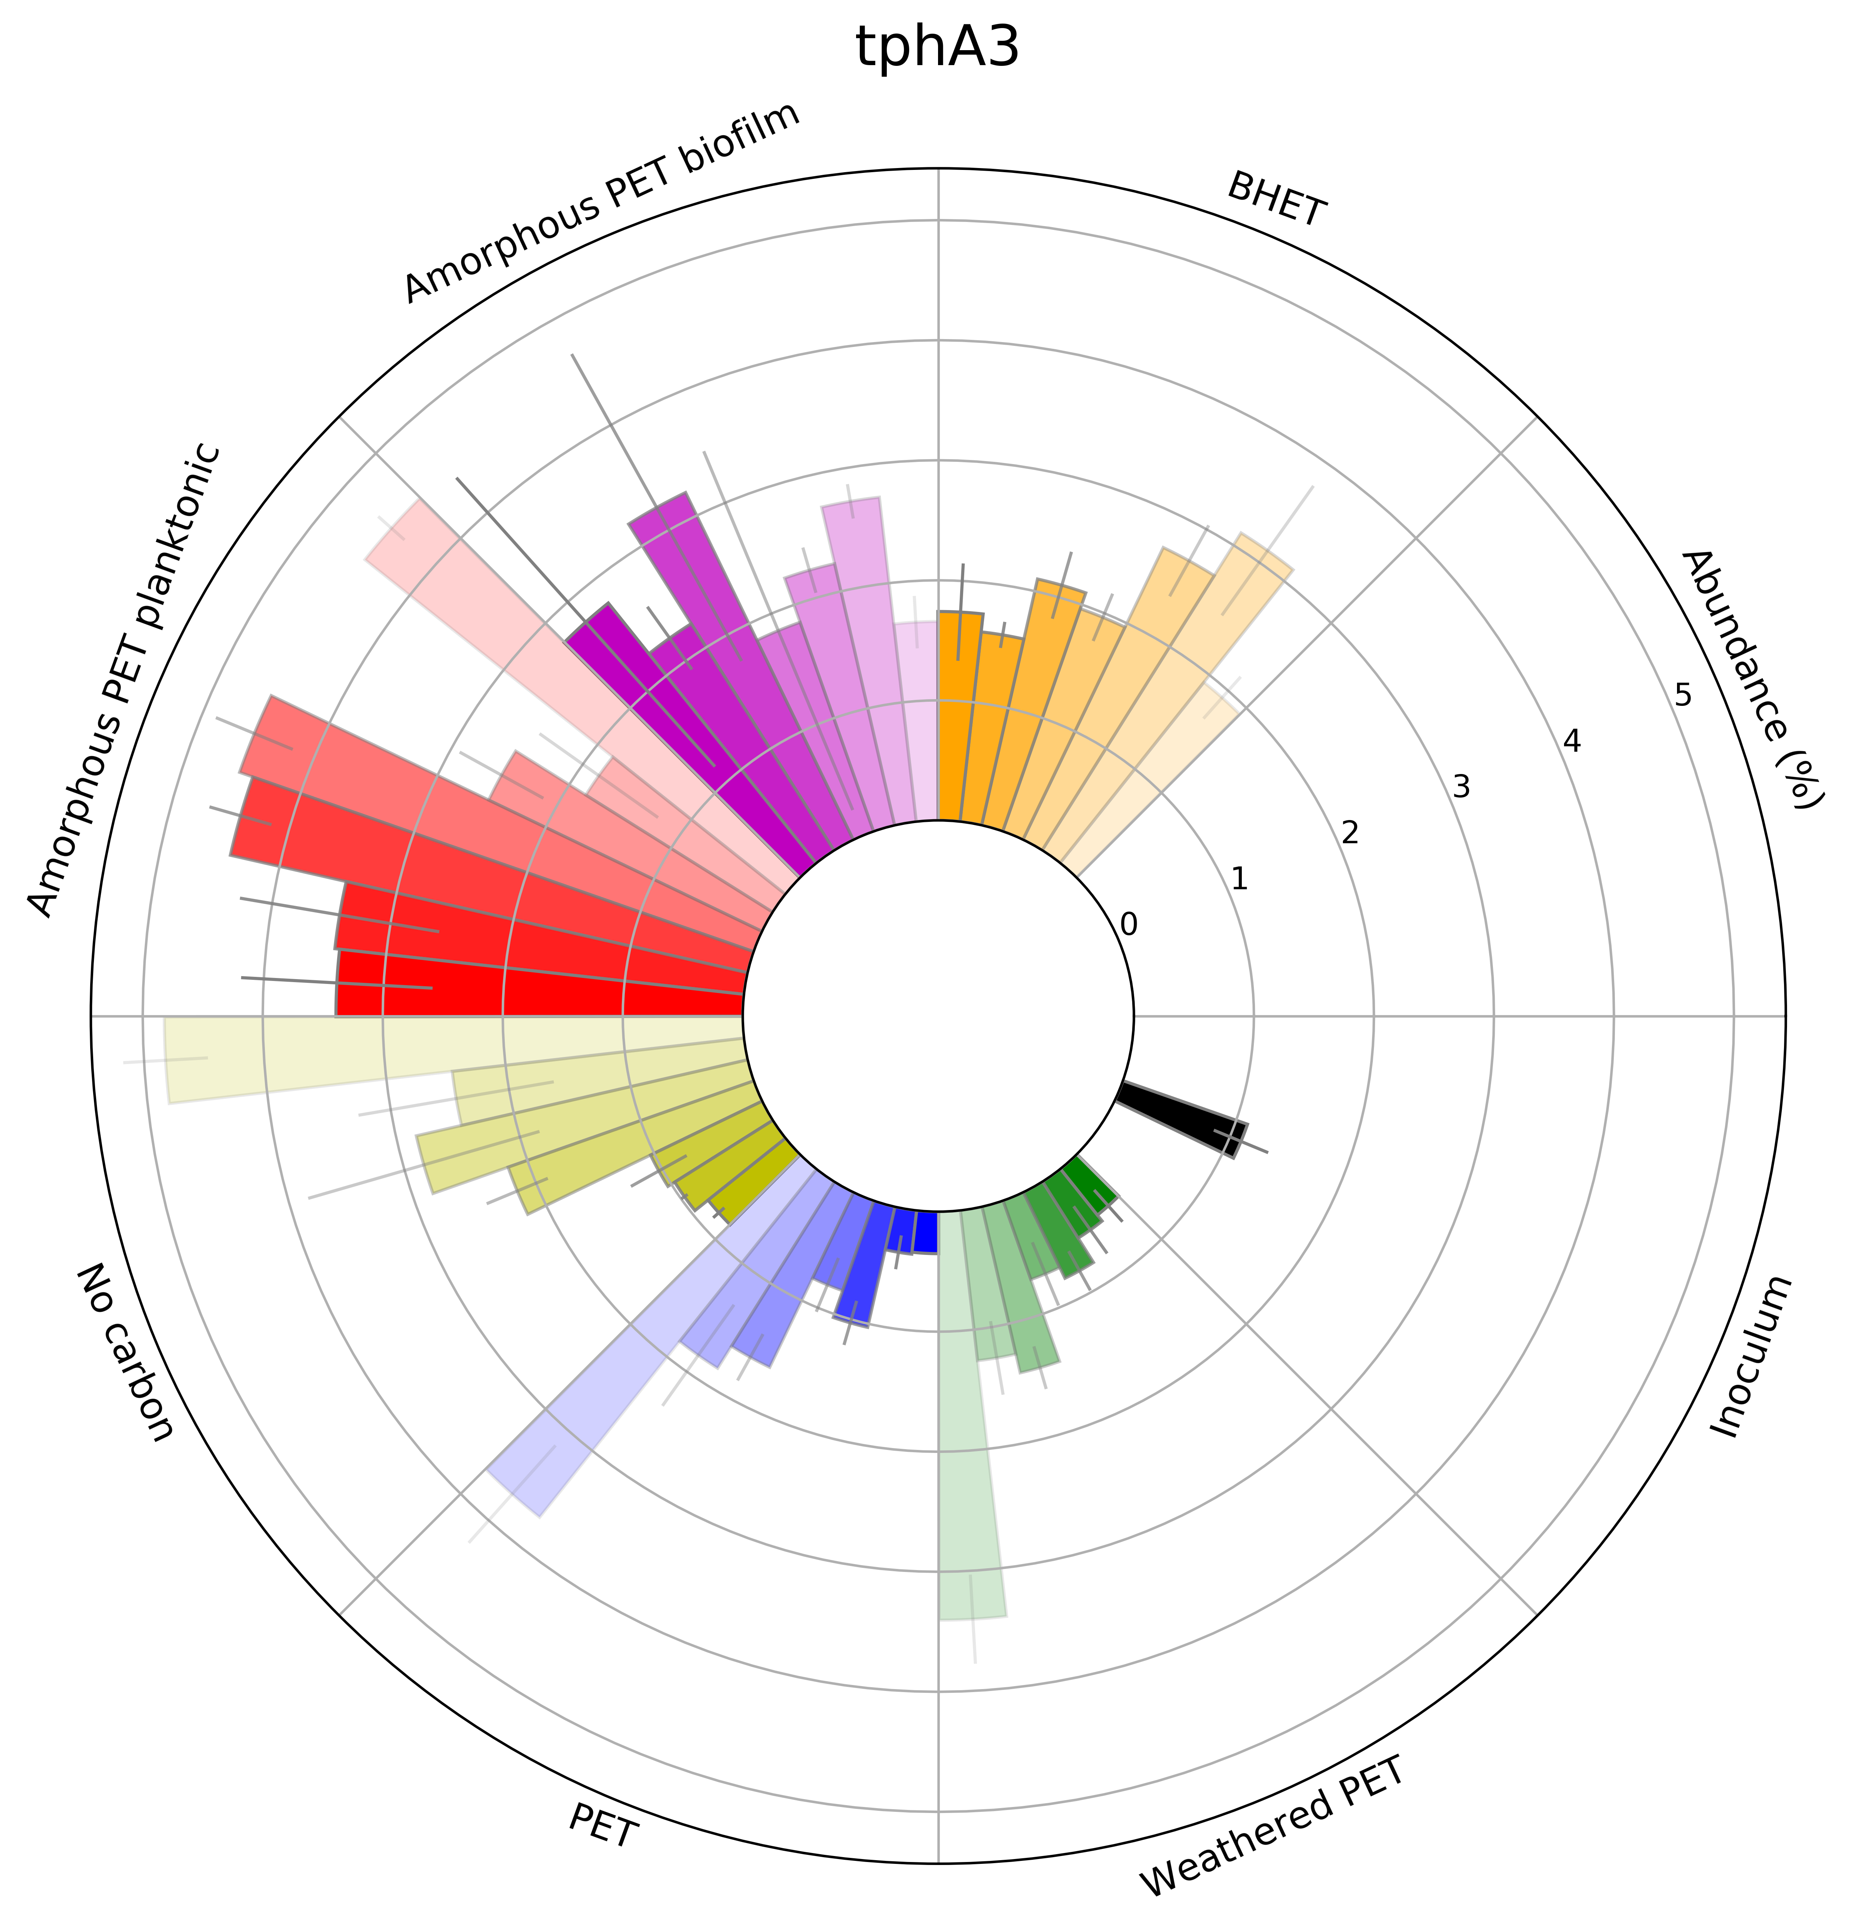
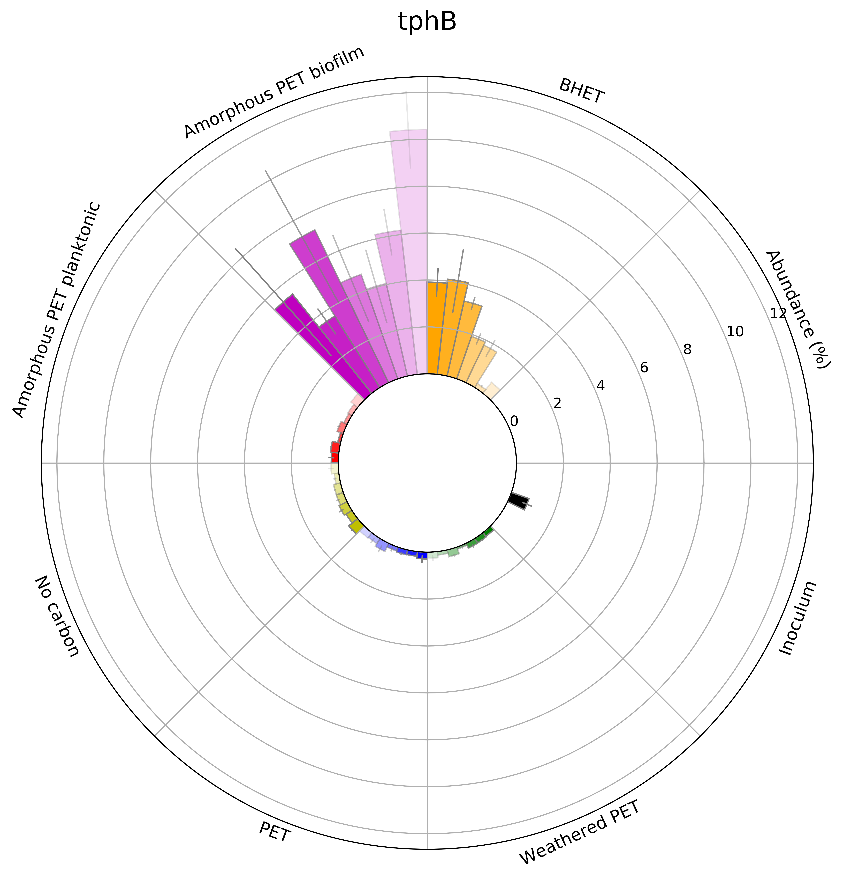


PET
BHET
MHET
TPA
﻿1,6-dihydroxycyclohexa-2,4-diene-dicarboxylate
Protocatechuate
𝛃 -carboxy muconate
𝛃 -ketoadipate pathway

Slide 4

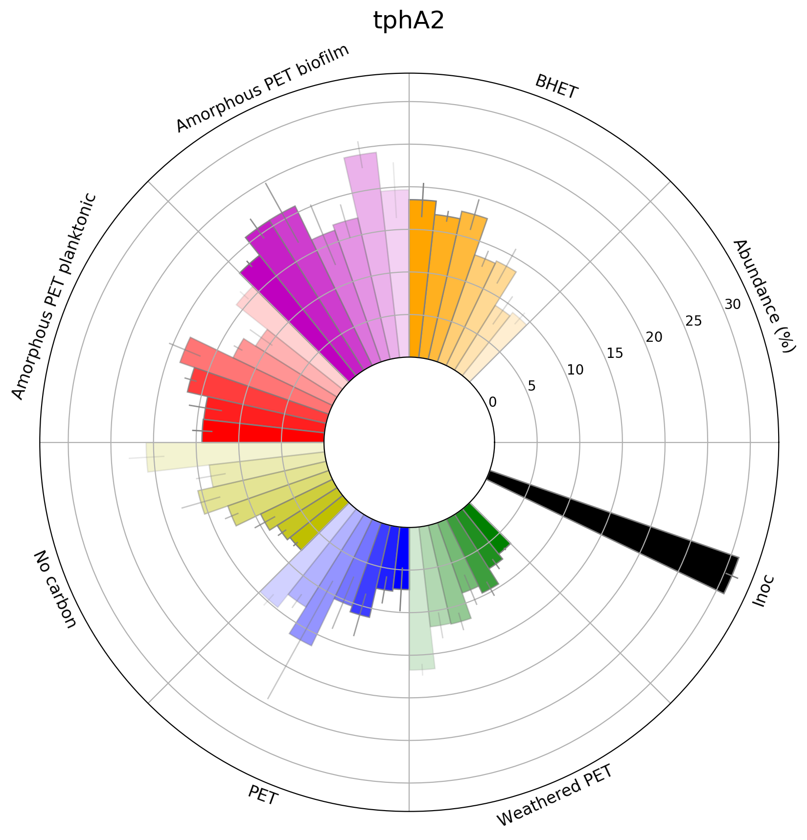

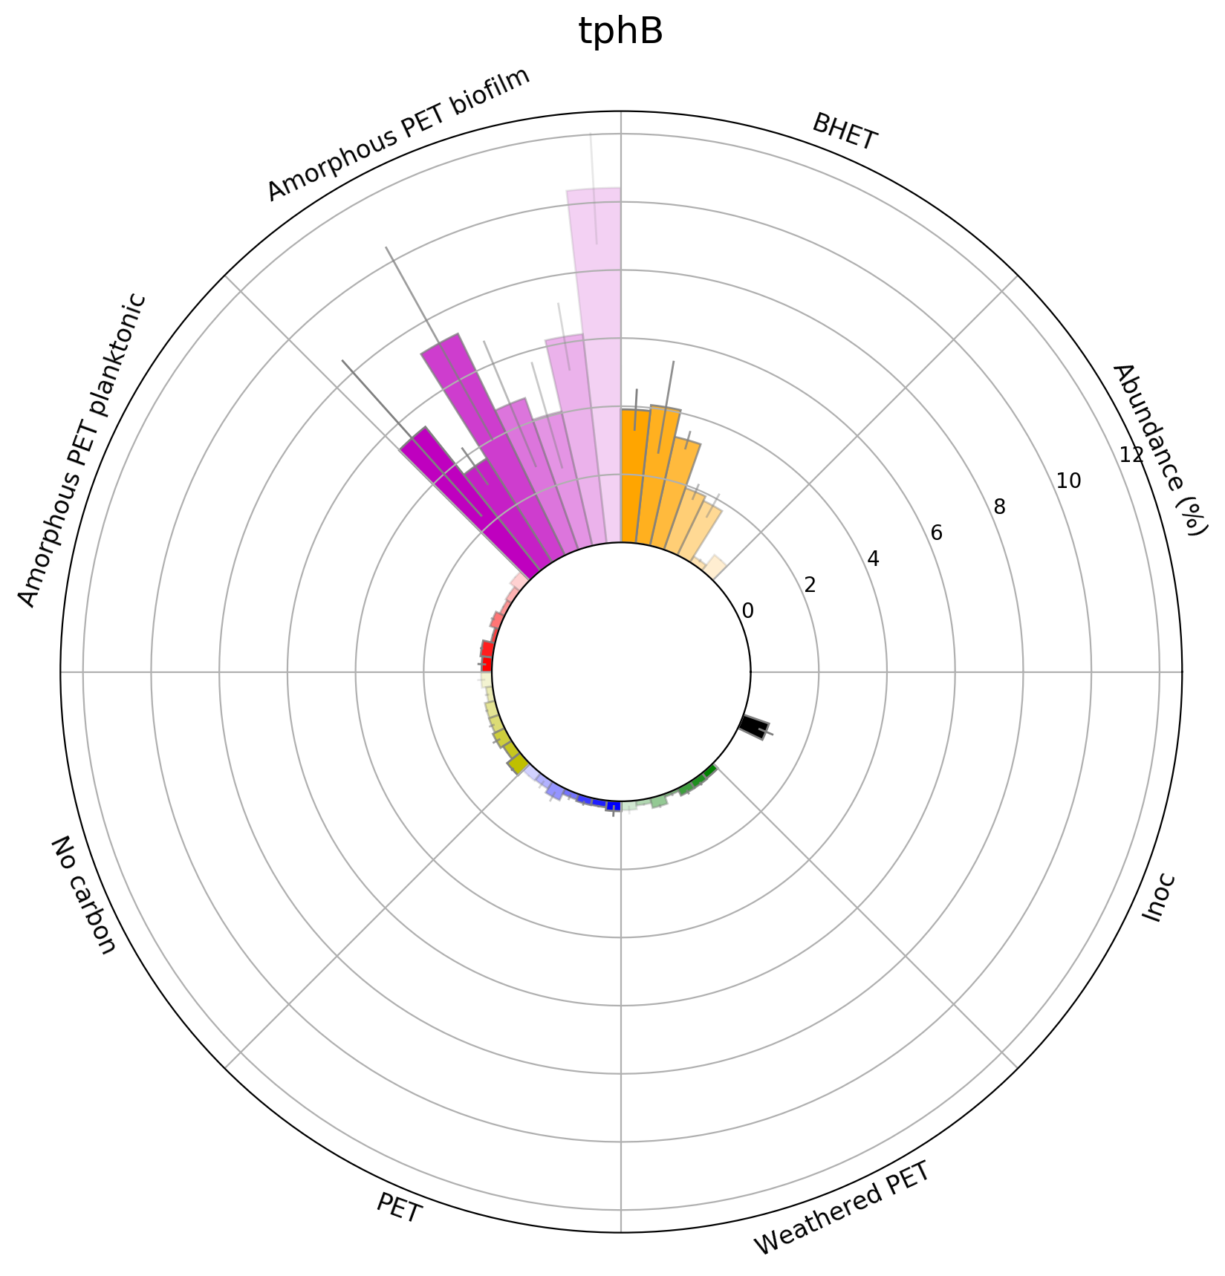
PET
BHET
MHET
TPA
﻿1,6-dihydroxycyclohexa-2,4-diene-dicarboxylate
Protocatechuate
𝛃 -carboxy muconate
𝛃 -ketoadipate pathway
Notes:
K18074 = tphA2
K18075 = tphA3
K18076 = tphB
TPA -> 1,6-dihydroxycyclohexa-2,4-diene-dicarboxylate (tphA2 and tphA3)
1,6-dihydroxycyclohexa-2,4-diene-dicarboxylate -> PCA (tphB)

Slide 5
